Slide 1
SQL
Join
Nested Queries

Slide 2
Join
An SQL join clause combines records from two or more tables in a database.
It creates a set that can be saved as a table or used as it is.
A JOIN is a means for combining fields from two tables by using values common to each
A programmer writes a JOIN statement to identify the records for joining. If the evaluated predicate is true, the combined record is then produced in the expected format, a record set or a temporary table..

Slide 3
Join Types
(SQL) Joins can be classified into the following categories :
Cartesian Products
Inner Joins (Equijoins)
Self Joins
Outer Joins (Left, Right and Full)
Note: As a special case, a table (base table, view, or joined table) can JOIN to itself in a self-join.

Slide 4
Cartesian Products (Cross Join)
join without a Join Condition
generate many rows of data, e.g., test data.
the base of all the other types of join.
In other words, it will produce rows which combine each row from the first table with each row from the second table.
Notes:
If a join is performed without a Join Condition then the Cartesian product of the specified tables is returned.
Cartesian products can generate many rows of (meaningless?) data, for this reason they are often used for creating test data. Apart from this, they have few practical uses.
Cartesian products form the base of all the other types of join.

Slide 5
Example:
Student
ID Name
123 John
124 Mary
125 Mark
126 Jane
SELECT * FROM
Student CROSS JOIN
Project
ID Name ID Code
123 John P123 DBS
124 Mary P123 DBS
125 Mark P123 DBS
126 Jane P123 DBS
123 John P124 PRG
124 Mary P124 PRG
125 Mark P124 PRG
126 Jane P124 PRG
123 John P124 DBS
124 Mary 124 DBS
Project
ID Code
P123 DBS
P124 PRG
P124 DBS
P126 PRG

Slide 6

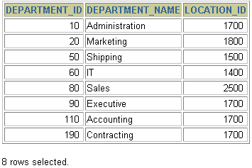

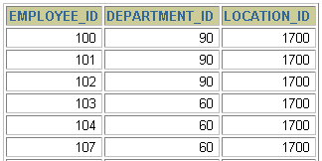
Generating a Cartesian Product
EMPLOYEES (20 rows)
DEPARTMENTS (8 rows)
…
Cartesian product: 20 x 8 = 160 rows
…
Notes:
Cartesian Products (continued)
A Cartesian product is generated if a join condition is omitted. The example in the slide displays employee last name and department name from the EMPLOYEES and DEPARTMENTS tables. Because no join condition has been specified, all rows (20 rows) from the EMPLOYEES table are joined with all rows (8 rows) in the DEPARTMENTS table, thereby generating 160 rows in the output.

Slide 7
INNER JOIN
An 'inner join' is the most common join operation used in applications and can be regarded as the default join-type.
Inner join creates a new result table by combining column values of two tables (A and B) based upon the join-predicate.
The result of the join can be defined as the outcome of first taking the Cartesian product (or Cross join) of all records in the tables (combining every record in table A with every record in table B) and then returning all records which satisfy the join predicate.

Slide 8
Inner join Cont.
The two tables must be joined by at least one common field. That is, the join field is a member of both tables.
Typically, a join operation is part of a SELECT query.
Syntax:
Select * from A, B where A.x = B.y The column names (x and y in this example) are often, but not necessarily, the same.
Example:
SELECT CustomerName, TransDate FROM Customer INNER JOIN Transaction ON Customer.CustomerID = Transaction.CustomerID;

Slide 9
SQL specifies two different syntactical ways to express joins:
The "explicit join notation" uses the JOIN keyword, optionally preceded by the INNER keyword, to specify the table to join, and the ON keyword to specify the predicates for the join:
SELECT * FROM employee INNER JOIN department ON employee.DepartmentID = department.DepartmentID;
The "implicit join notation" simply lists the tables for joining without using JOIN keyword.
SELECT * FROM employee, department WHERE employee.DepartmentID = department.DepartmentID;

Slide 10
Example with using clause:
Student
ID Name
123 John
124 Mary
125 Mark
126 Jane
SELECT * FROM
Student INNER JOIN Enrolment USING (ID)
ID Name ID Code
123 John 123 DBS
124 Mary 124 PRG
124 Mary 124 DBS
126 Jane 126 PRG
Enrolment
ID Code
123 DBS
124 PRG
124 DBS
126 PRG

Slide 11
Creating Joins with the ON Clause
Use the ON clause to specify arbitrary conditions or specify columns to join.
The join condition is separated from other search conditions.
The ON clause makes code easy to understand.
Notes:
ON Clause
Use the ON clause to specify a join condition. This lets you specify join conditions separate from any search or filter conditions in the WHERE clause.

Slide 12
Example with on clause:
Buyer
Name Budget
Smith 100,000
Jones 150,000
Green 80,000
SELECT * FROM Buyer as B, Property as P
ON P.Price <= B.Budget
Property
Address Price
15 High St 85,000
12 Queen St 125,000
87 Oak Row 175,000
Name Budget Address Price
Smith 100,000 15 High St 85,000
Jones 150,000 15 High St 85,000
Jones 150,000 12 Queen St 125,000

Slide 13
INNER JOIN cont.
SELECT * FROM
A INNER JOIN B
ON <condition>
is the same as
SELECT * FROM A, B
WHERE <condition>
SELECT * FROM
A INNER JOIN B
USING(col1, col2,...)
is the same as
SELECT * FROM A, B
WHERE A.col1 = B.col1
AND A.col2 = B.col2
AND ...

Slide 14
Equijoins
An equi-join is a specific type of comparator-based join, that uses only equality comparisons in the join-predicate.
Using other comparison operators (such as <) disqualifies a join as an equi-join.
The order of the tables listed in the FROM clause should have no significance.

Slide 15
Natural join
A natural join is a type of equi-join that only work if the column you are joining by has same name in both tables.
The resulting joined table contains only one column for each pair of equally named columns.

Slide 16
NATURAL JOIN
Student
ID Name
123 John
124 Mary
125 Mark
126 Jane
SELECT * FROM
Student NATURAL JOIN Enrolment
ID Name
123 John
124 Mary
124 Mary
126 Jane
Code
Enrolment
ID Code
123 DBS
124 PRG
124 DBS
126 PRG
DBS
PRG
DBS
PRG
The join condition for the natural join is basically an equijoin of all columns with the same name.

Slide 17
Self Join
A Self Join is a join of a table to itself.
Put the table in the FROM clause twice. Self joins are very useful.
Use aliases to distinguish columns in the WHERE clause.
Syntax:
The basic syntax of SELF JOIN is as follows:
SELECT a.column_name, b.column_name
FROM table1 a, table1 b
WHERE a.common_filed = b.common_field;

Slide 18
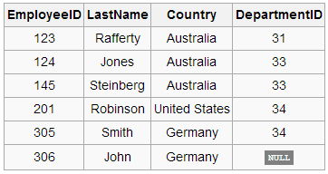
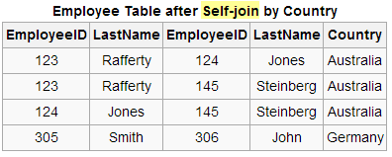
Example
A query to find all pairings of two employees in the same country is desired.
SELECT e1.EmployeeID, e1.LastName, e2.EmployeeID, e2.LastName, e2.Country
FROM Employee As e1, Employee As e2 WHERE e1.Country = e2.Country;
Can also write like
this: without writing As
Employee e1, Employee e2

Slide 19
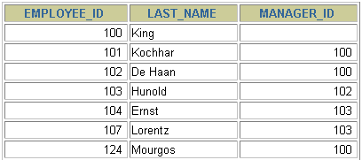
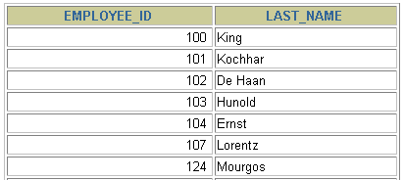
Self-Joins Using the ON Clause
EMPLOYEES (WORKER)
EMPLOYEES (MANAGER)
…
…
MANAGER_ID in the WORKER table is equal to EMPLOYEE_ID in the MANAGER table.
Notes:
Joining a Table to Itself
Sometimes you need to join a table to itself. To find the name of each employee’s manager, you need to join the EMPLOYEES table to itself, or perform a self join. For example, to find the name of Lorentz’s manager, you need to:
Find Lorentz in the EMPLOYEES table by looking at the LAST_NAME column.
Find the manager number for Lorentz by looking at the MANAGER_ID column. Lorentz’s manager number is 103.
Find the name of the manager with EMPLOYEE_ID 103 by looking at the LAST_NAME column. Hunold’s employee number is 103, so Hunold is Lorentz’s manager.
In this process, you look in the table twice. The first time you look in the table to find Lorentz in the LAST_NAME column and MANAGER_ID value of 103. The second time you look in the EMPLOYEE_ID column to find 103 and the LAST_NAME column to find Hunold.

Slide 20
Outer Join
An Inner Join excludes rows from either table that don't have a matching row in the other table.
An Outer Join allows us to return unmatched rows.
Outer Joins come in three varieties :
LEFT ( MATCHED ROWS IN RIGHT TABLE AND ALL ROWS IN LEFT TABLE )
RIGHT ( MATCHED ROWS IN LEFT TABLE AND ALL ROWS IN RIGHT TABLE )
FULL ( ALL ROWS IN ALL TABLES IT DOESN'T MATTERS EVEN MATCH IS THERE OR NOT )

Slide 21
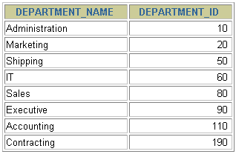
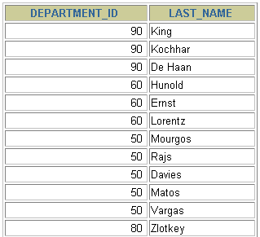
Outer Joins
DEPARTMENTS
EMPLOYEES
…
There are no employees in department 190.
Returning Records with No Direct Match with Outer Joins
If a row does not satisfy a join condition, the row does not appear in the query result. For example, in the equijoin condition of EMPLOYEES and DEPARTMENTS tables, department ID 190 does not appear because there are no employees with that department ID recorded in the EMPLOYEES table. Instead of seeing 20 employees in the result set, you see 19 records.
To return the department record that does not have any employees, you can use an outer join.

Slide 22

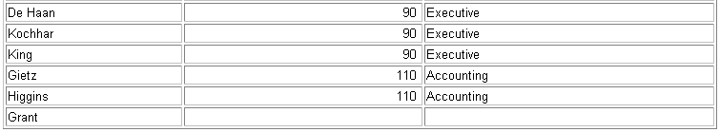
LEFT OUTER JOIN
A left outer join will give all rows in A, plus any common rows in B
SELECT e.last_name, d.department_id, d.department_name
FROM employees e LEFT OUTER JOIN departments d
ON (e.department_id = d.department_id) ;
…
Example of LEFT OUTER JOIN
This query retrieves all rows in the EMPLOYEES table, which is the left table even if there is no match in the DEPARTMENTS table.

Slide 23
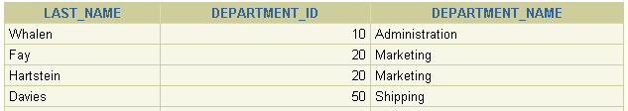
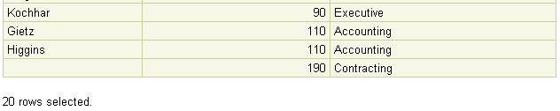
RIGHT OUTER JOIN
SELECT e.last_name, d.department_id, d.department_name
FROM employees e RIGHT OUTER JOIN departments d
ON (e.department_id = d.department_id) ;
…
Example of RIGHT OUTER JOIN
This query retrieves all rows in the DEPARTMENTS table, which is the right table even if there is no match in the EMPLOYEES table.

Slide 24
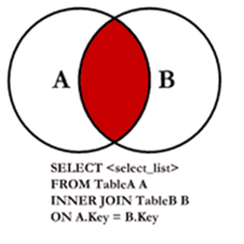
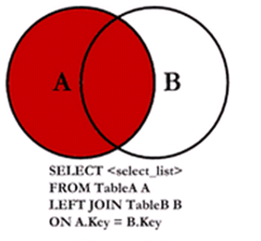
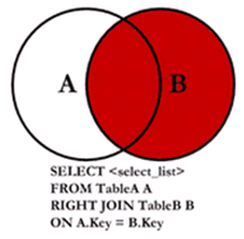
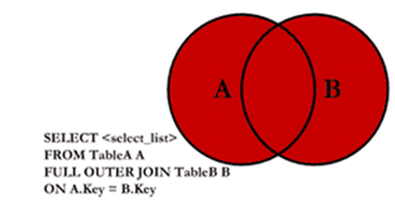
Sql Joins
INNER JOIN
LEFT OUTER JOIN
RIGHT OUTER JOIN
FULL OUTER JOIN

Slide 25
Nested Subqueries
SQL provides a mechanism for the nesting of subqueries.
A subquery is a select-from-where expression that is nested within another query.
It is possible to embed a SQL statement within another.
What is subquery useful for?
First, it can also be used to join tables.
Also, there are cases where the only way to correlate two tables is through a subquery.

Slide 26
The syntax is as follows:
SELECT "column_name1" FROM "table_name" WHERE "column_name2" [Comparison Operator] (SELECT "column_name1" FROM "table_name" WHERE [Condition])
[Comparison Operator] could be equality operators such as =, >, <, >=, <=. It can also be a text operator such as "LIKE."

Slide 27
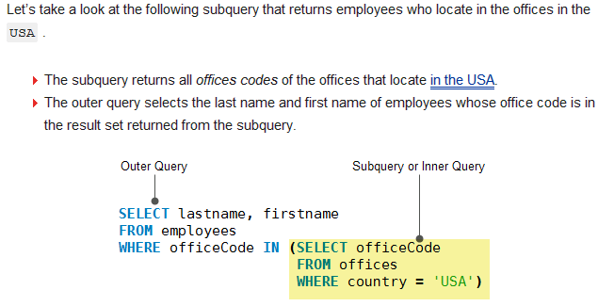

Slide 28
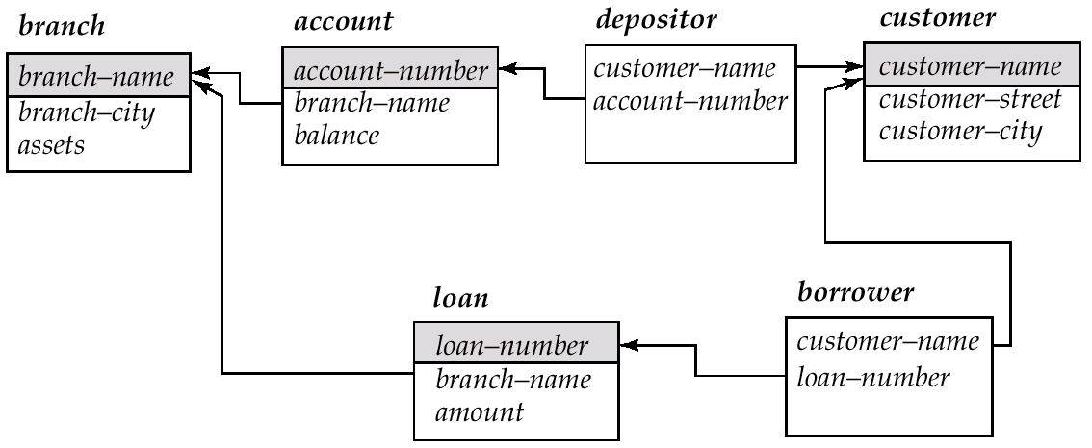
Schema Used in Examples

Slide 29
“In” Construct
Find all customers who have both an account and a loan at the bank.
select distinct customer_name from borrower where customer_name in (select customer_name from depositor )
Find all customers who have a loan at the bank but do not have an account at the bank
select distinct customer_name from borrower where customer_name not in (select customer_name from depositor )

Slide 30
Table Store_Information
Table Geography
Store name | Sales | Date
Los Angeles | $1500 | Jan-05-1999
San Diego | $250 | Jan-07-1999
Los Angeles | $300 | Jan-08-1999
Boston | $700 | Jan-08-1999
Region_name | Store_name
East | Boston
East | New York
West | Los Angeles
West | San Diego
Find the sales of all stores in the West region. To do so, we use the following SQL statement:
SELECT SUM(Sales) FROM Store_Information WHERE Store_name IN (SELECT store_name FROM Geography WHERE region_name = 'West')
SUM(Sales)
2050
In this example, instead of joining the two tables directly and then adding up only the sales amount for stores in the West region, we first use the subquery to find out which stores are in the West region, and then we sum up the sales amount for these stores.

Slide 31
“Some” Construct
Find all branches that have greater assets than some branch located in Brooklyn.
select distinct T.branch_name from branch as T, branch as S where T.assets > S.assets and S.branch_city = 'Brooklyn'
Same query using > some clause
select branch_name from branch where assets > some (select assets from branch where branch_city = 'Brooklyn')

Slide 32
“All” Construct
Find the names of all branches that have greater assets than all branches located in Brooklyn.
select branch_name from branch where assets > all (select assets from branch where branch_city = 'Brooklyn')

Slide 33
Exist construct in nested query
When a subquery is used with EXISTS or NOT EXISTS operator, a subquery returns a Boolean value of TRUE or FALSE.
The subquery acts as an existence check.
EXISTS simply tests whether the inner query returns any row. If it does, then the outer query proceeds. If not, the outer query does not execute, and the entire SQL statement returns nothing.

Slide 34
Table Store_Information
Table Geography
Store name | Sales | Date
Los Angeles | $1500 | Jan-05-1999
San Diego | $250 | Jan-07-1999
Los Angeles | $300 | Jan-08-1999
Boston | $700 | Jan-08-1999
Region_name | Store_name
East | Boston
East | New York
West | Los Angeles
West | San Diego
Find the sales of all stores in the West region. To do so, we use the following SQL statement:
SELECT SUM(Sales) FROM Store_Information WHERE EXISTS (SELECT * FROM Geography WHERE Region_Name = 'West');
SUM(Sales)
2750
At first, this may appear confusing, because the subquery includes the [region_name = 'West'] condition, yet the query summed up stores for all regions. Upon closer inspection, we find that since the subquery returns more than 0 row, the EXISTS condition is true, and the condition placed inside the inner query does not influence how the outer query is run.

